Slide 1
Key Findings from Customer Sentiment Analysis
Insights into British Airways Customer Satisfaction and Recommendations
Presented by
Abiola Adewale

Slide 2
The Discussion
Overall Customer Sentiment
Feature-wise Analysis
Temporal Analysis
Recommending vs Not Recommending
Value for Money Ratings
Textual Analysis
Impact of Travel Type on Satisfaction
Impact of Seat Type on Satisfaction

Slide 3
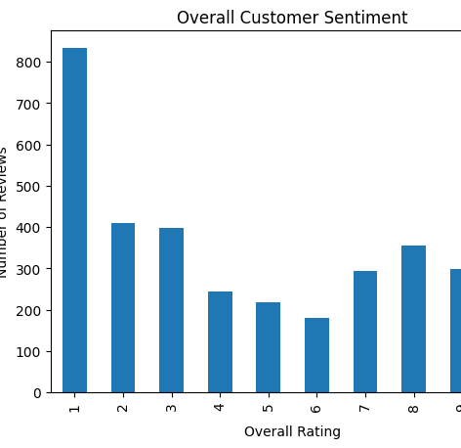
Overall Customer Sentiment
Most customers have given a rating of 1, indicating high dissatisfaction.
Fewer customers have given mid-range ratings (2-6).
The number of reviews increases again for higher ratings (7-10), showing some level of satisfaction among another group of customers.
This polarization suggests a need for further investigation into the factors causing extreme customer reactions.

Slide 4
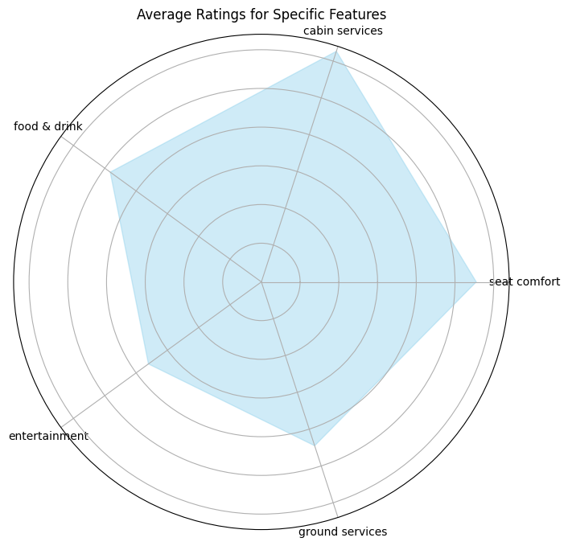
Feature-wise Analysis
The chart represents average customer ratings for specific features of an airline.
The highest ratings are for “food & drink” and “cabin services”.
The lowest ratings are for “seat comfort” and “ground services”.
This suggests areas where the airline excels and where improvements could be made.

Slide 5
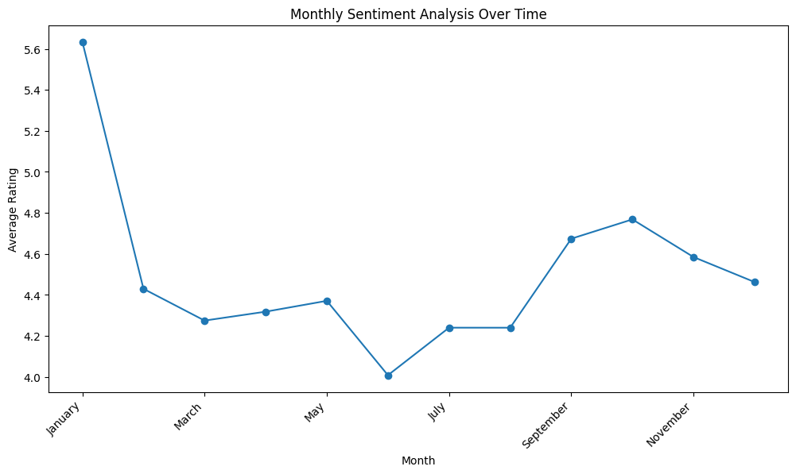
Temporal Analysis
January to March: Decrease
Winter ?
March to May: Slight Increase
Spring?
May to June: Drastic Drop
Any specific event?
May to October: Increase
Summer?
October to December: Decrease
End of Year weather?

Slide 6
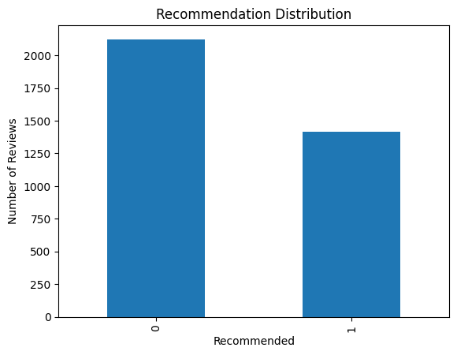
Recommending vs Not Recommending
Recommended: 1,418
Not Recommended: 2,116
Ratio: approximately 0.67

Slide 7
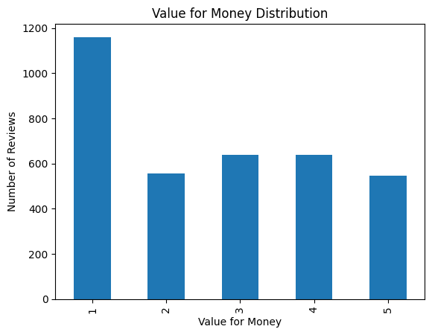
Value for Money Ratings
1 Star: 1,158 ratings
2 Stars: 553 ratings
3 Stars: 638 ratings
4 Stars: 640 ratings
5 Stars: 545 ratings

Slide 8
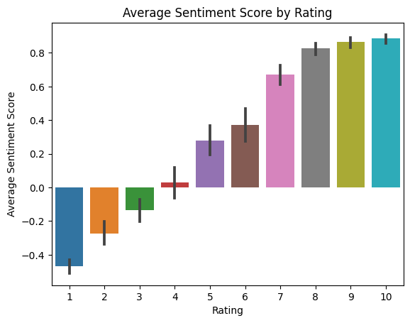
Textual Analysis
Sentiment Analysis: as expected, the lower the sentiment score, the lower the rating.

Slide 9
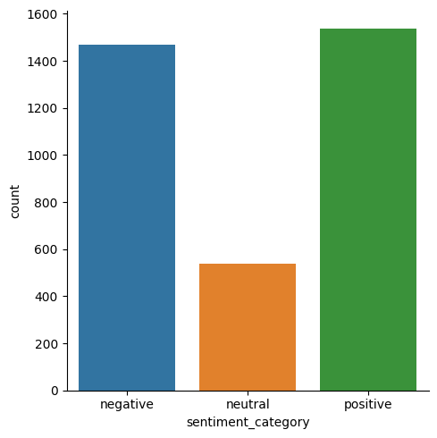
Textual Analysis
Sentiment Categories:
Positive Sentiments: 1,536 instances
Negative Sentiments: 1,467 instances
Neutral Sentiments: 537 instances

Slide 10
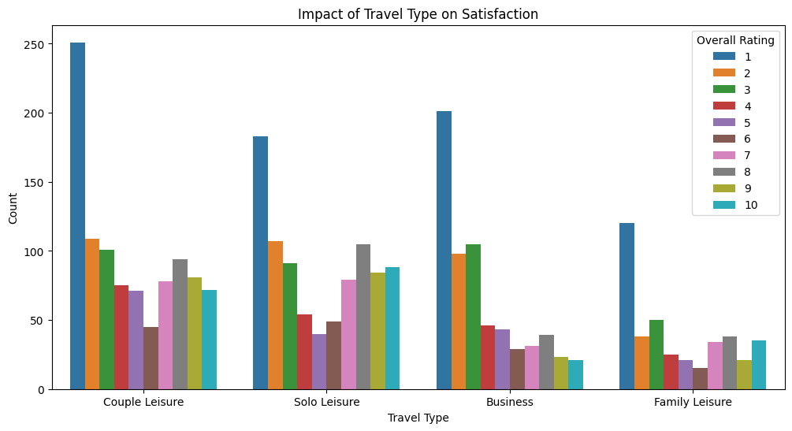
Impact of Travel Type on Satisfaction
“Couple Leisure” and “Family Leisure” have higher counts of satisfaction ratings.
“Business” has a lower count of satisfaction ratings.
“Solo Leisure” has a moderate count of satisfaction ratings

Slide 11
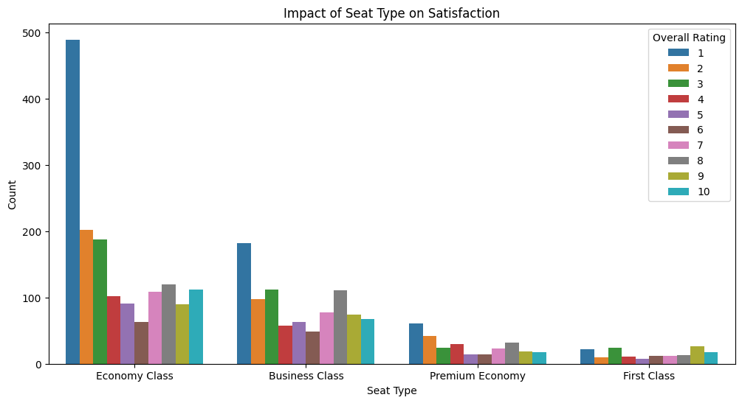
Impact of Seat Type on Satisfaction
“Economy Class” has a high count but low overall rating, indicating low satisfaction.
“First Class” has a low count but high overall rating, indicating high satisfaction.
This suggests that seat type significantly impacts customer satisfaction.

Slide 12
THANK YOU

